Slide 1
Measures of Central Tendency

Slide 2
Measures of Central Tendency
A Measure of Location summarizes a data set by giving a “single quantitative value” within the range of the data values that describes its location relative to entire data set.
Some Common Measures are:
Arithmetic Mean / Average
Geometric Mean
Harmonic Mean
Median
Mode

Slide 3
Arithmetic mean / mean
Most common measure of the center
Obtained by dividing the SUM of all the observations by the total number of observations
Population Mean
Sample Mean

Slide 4
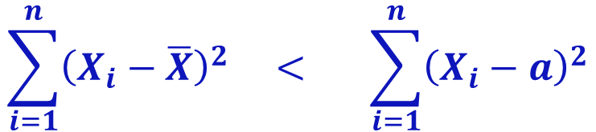

Properties of Arithmetic mean
Mean of the constant is equal to that constant
The sum of the deviations of the observations from their mean is equal to zero. i.e.,
The sum of squared deviations of the observations from their mean is minimum
Where a is any constant
$$\sum_{i=1}^{n}{\left(X_{i}−\overline{X}\right)=0}$$
$$\sum_{i=1}^{n}{{\left(X_{i}−\overline{X}\right)}^{2}} < \sum_{i=1}^{n}{{\left(X_{i}−a\right)}^{2}}$$

Slide 5
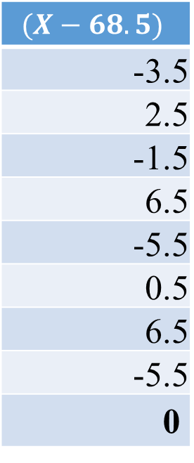

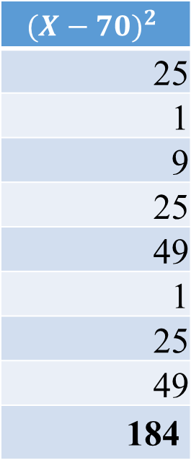
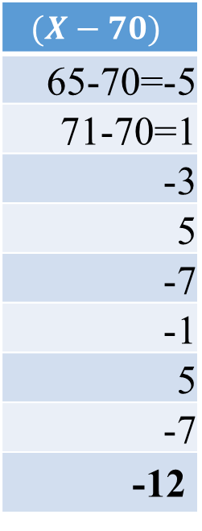
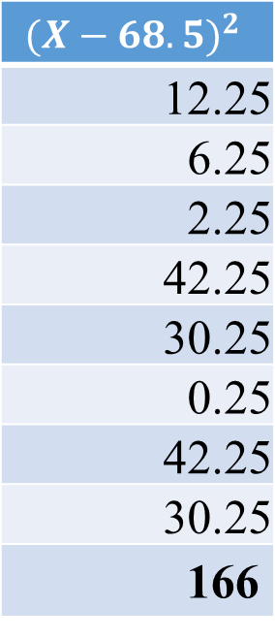
Properties of Arithmetic mean
X
65
71
67
75
63
69
75
63
548
$$(X−68.5)$$
-3.5
2.5
-1.5
6.5
-5.5
0.5
6.5
-5.5
0
$${(X−68.5)}^{2}$$
12.25
6.25
2.25
42.25
30.25
0.25
42.25
30.25
166
$$(X−70)$$
65-70=-5
71-70=1
-3
5
-7
-1
5
-7
-12
$${(X−70)}^{2}$$
25
1
9
25
49
1
25
49
184
$$\overline{X}=\frac{\sum{X}}{n}=\frac{548}{8}=68.5$$

Slide 6
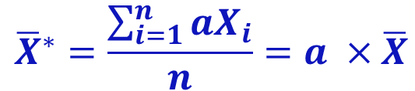
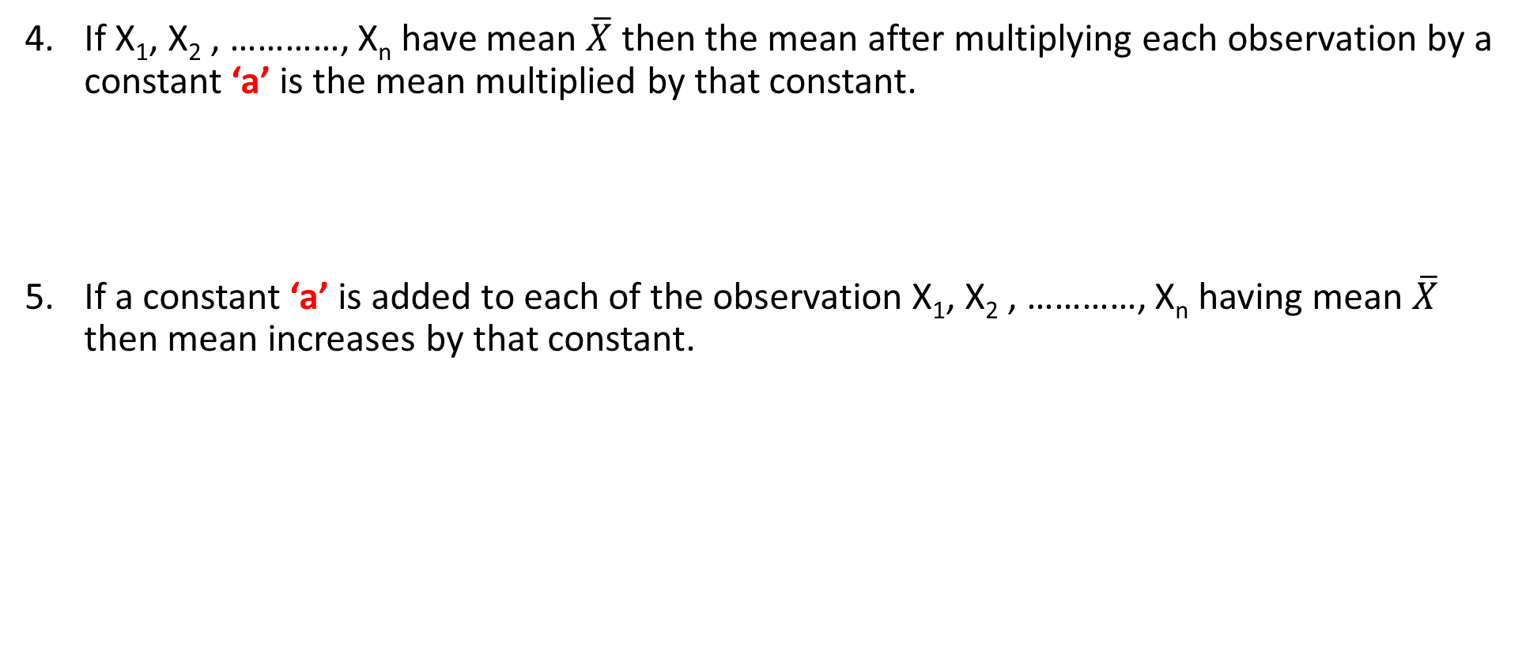
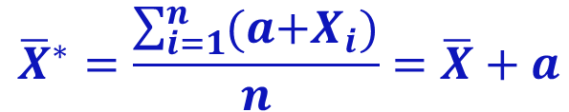
Properties of Arithmetic mean
If X₁, X₂ , …………, X_{n} have mean $\overline{X}$ then the mean after multiplying each observation by a constant ‘a’ is the mean multiplied by that constant.
If a constant ‘a’ is added to each of the observation X₁, X₂ , …………, X_{n} having mean $\overline{X}$ then mean increases by that constant.
$${\overline{X}}^{∗}=\frac{\sum_{i=1}^{n}{aX_{i}}}{n}=a ×\overline{X}$$
$${\overline{X}}^{∗}=\frac{\sum_{i=1}^{n}{(a{+X}_{i})}}{n}=\overline{X}+a$$

Slide 7
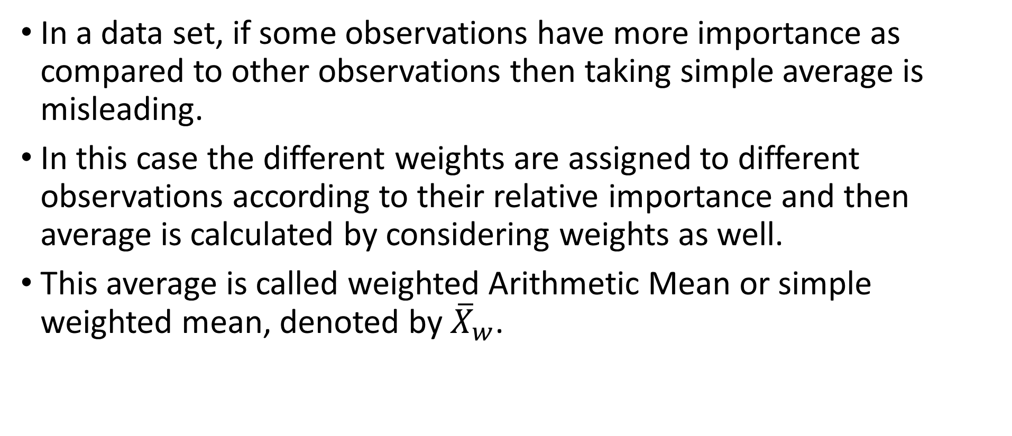
Weighted arithmetic mean
In a data set, if some observations have more importance as compared to other observations then taking simple average is misleading.
In this case the different weights are assigned to different observations according to their relative importance and then average is calculated by considering weights as well.
This average is called weighted Arithmetic Mean or simple weighted mean, denoted by ${\overline{X}}_{w}$.

Slide 8
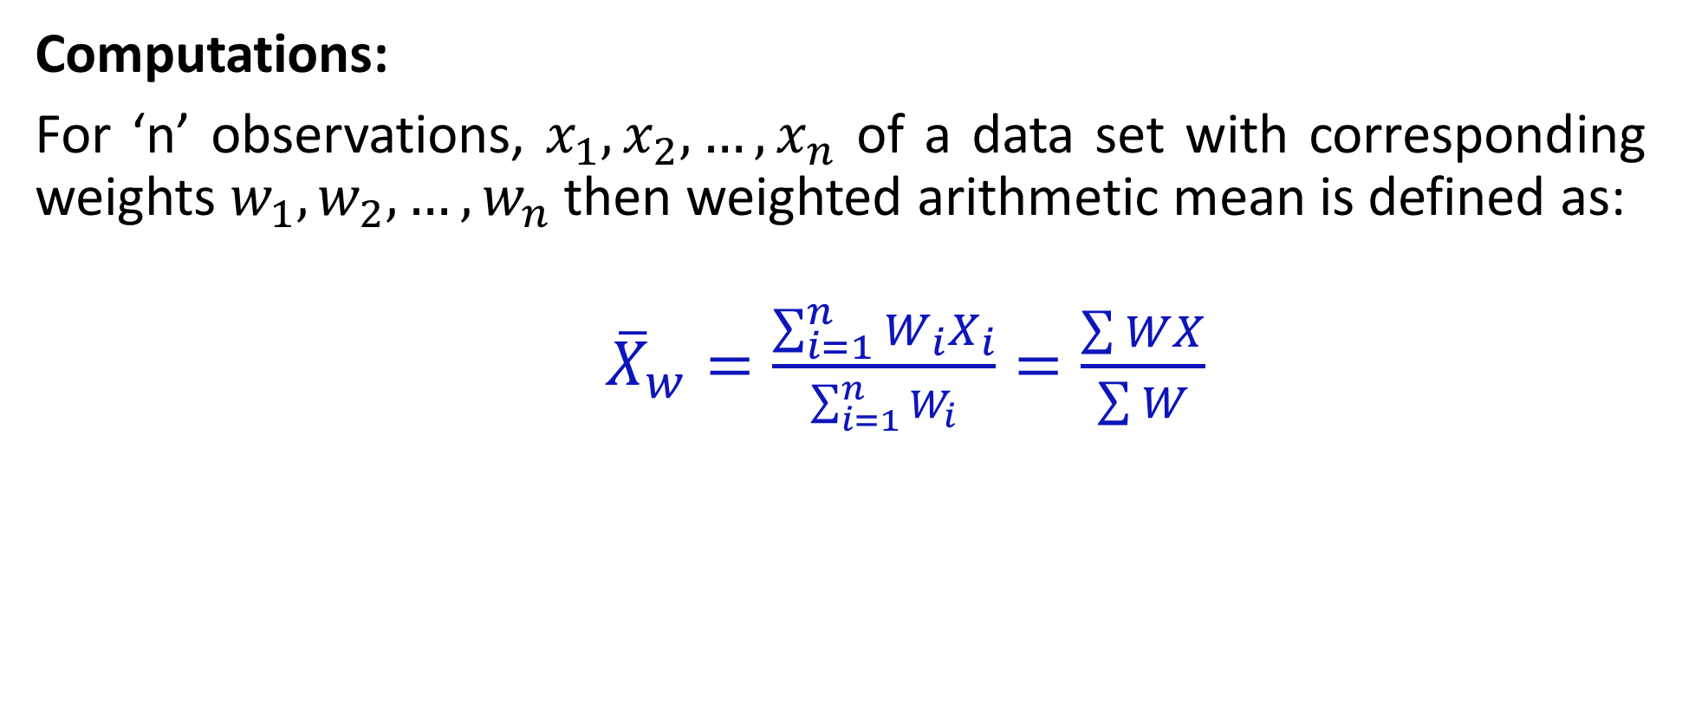
Weighted arithmetic mean
Computations:
For ‘n’ observations, $x_{1},x_{2},…,x_{n}$ of a data set with corresponding weights $w_{1},w_{2},…,w_{n}$then weighted arithmetic mean is defined as:
${\overline{X}}_{w}=\frac{\sum_{i=1}^{n}{W_{i}X_{i}}}{\sum_{i=1}^{n}{W_{i}}}=\frac{\sum{WX}}{\sum{W}}$

Slide 9
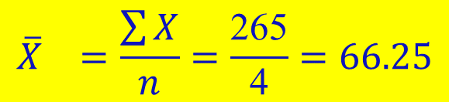
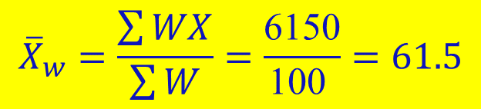
Weighted A.M - Calculations
Subjects | Marks (X_{i}) | Weights (W_{i})
Statistics | 80 | 20
Mathematics | 75 | 10
Chemistry | 50 | 40
English | 60 | 30
Total | 265 | 100
Weights W_{i}X_{i}
1600
750
2000
1800
6150
$${\overline{X}}_{}=\frac{\sum{X}}{n}=\frac{\text{265}}{\text{4}}=66.25$$
$${\overline{X}}_{w}=\frac{\sum{WX}}{\sum{W}}=\frac{\text{6150}}{\text{100} }=61.5$$

Slide 10
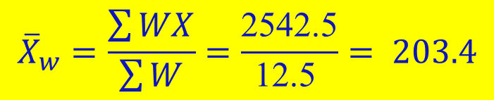
Weighted A.M - Calculations
Items | Expenditure (Rs.) (x_{i}) | Weights (w_{i})
Food | 290 | 7.5
Rent | 54 | 2
Clothing | 98 | 1.5
Fuel and Light | 75 | 1
Others | 75 | 0.5
Total |  | 12.5
X_{i} w_{i}
2175
108
147
75
37.5
2542.5
$${\overline{X}}_{w}=\frac{\sum{WX}}{\sum{W}}=\frac{\text{2542.5}}{\text{12.5 }}= 203.4$$

Slide 11
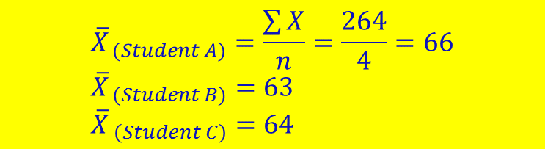
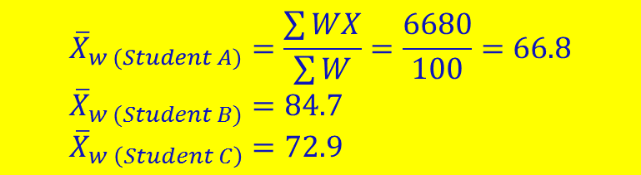
Example
An examination was held to decide about the award of a scholarship in an institution. The weights of various subjects were different. The marks obtained by 3 candidates ( A,B,C) out of 100 are given below. If the candidate getting the height average score is to be awarded the scholarship, who should get it
Subject | Weights (%) | XA | XB | XC
Statistics | 40 | 70 | 80 | 91
Mathematics | 30 | 70 | 75 | 80
Economics | 20 | 54 | 57 | 40
English | 10 | 70 | 40 | 45
TOTAL | 100 | 264 | 252 | 256
WXA | WXB | WXC
2800 | 2400 | 3640
2100 | 1500 | 2400
1080 | 570 | 800
700 | 4000 | 450
6680 | 8470 | 7290
If there are no weights involved
$${\overline{X}}_{ (Student A)}=\frac{\sum{X}}{n}=\frac{264}{4}=66 \\ {\overline{X}}_{ (Student B)}=63 \\ {\overline{X}}_{ \left(Student C\right)}=64$$
$${\overline{X}}_{w (Student A)}=\frac{\sum{WX}}{\sum{W}}=\frac{6680}{100}=66.8 \\ {\overline{X}}_{w (Student B)}=84.7 \\ {\overline{X}}_{w \left(Student C\right)}=72.9$$

Slide 12
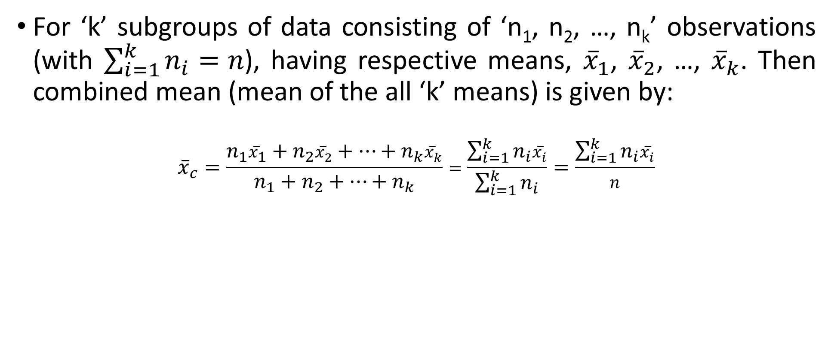
Combined Mean
For ‘k’ subgroups of data consisting of ‘n₁, n₂, …, n_{k}’ observations (with $\sum_{i=1}^{k}{n_{i}=n}$), having respective means, ${\overline{x}}_{1}$, ${\overline{x}}_{2}$, …, ${\overline{x}}_{k}$. Then combined mean (mean of the all ‘k’ means) is given by:
$${\overline{x}}_{c}=\frac{n_{1}{\overline{x}}_{1}+n_{2}{\overline{x}}_{2}+…+n_{k}{\overline{x}}_{k}}{n_{1}+n_{2}+…+n_{k}}=\frac{\sum_{i=1}^{k}{n_{i}{\overline{x}}_{i}}}{\sum_{i=1}^{k}{n_{i}}}=\frac{\sum_{i=1}^{k}{n_{i}{\overline{x}}_{i}}}{n}$$

Slide 13
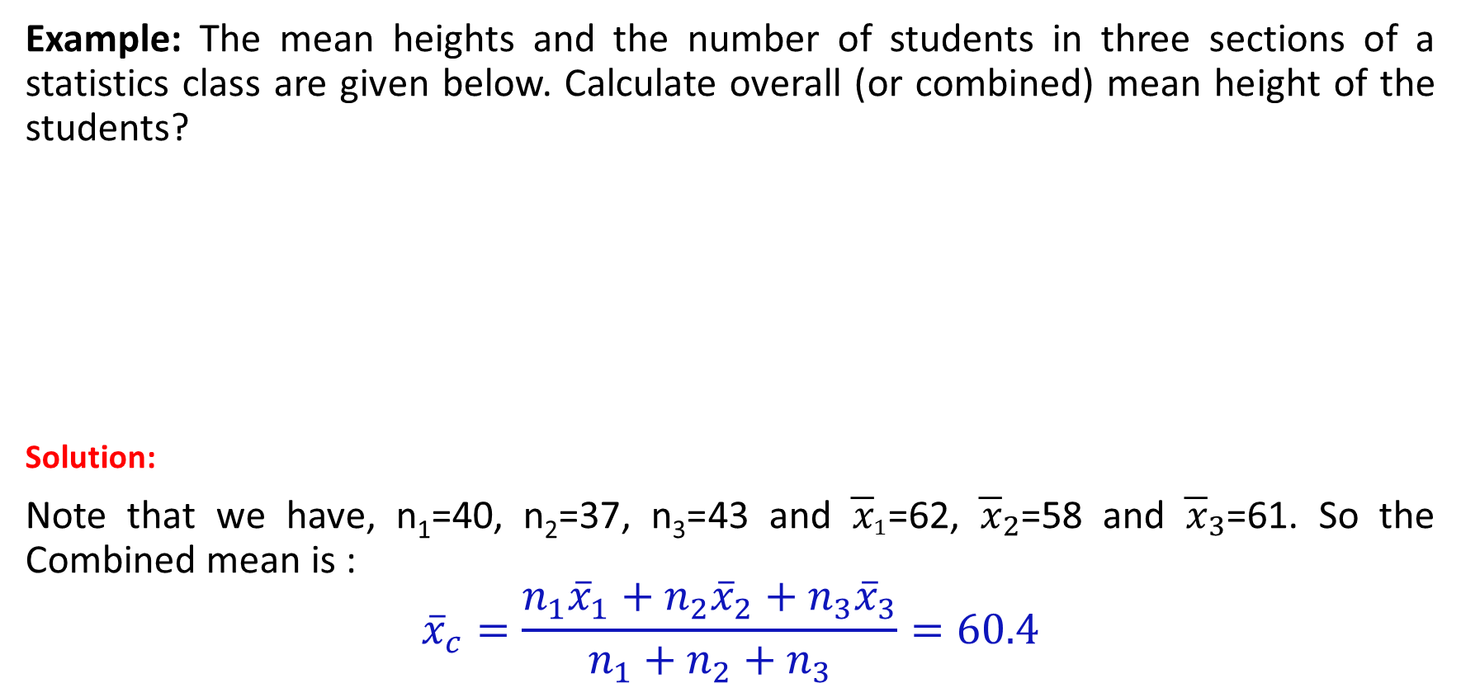
Combined Mean
Example: The mean heights and the number of students in three sections of a statistics class are given below. Calculate overall (or combined) mean height of the students?
Solution:
Note that we have, n₁=40, n₂=37, n₃=43 and ${\overline{x}}_{1}$=62, ${\overline{x}}_{2}$=58 and ${\overline{x}}_{3}$=61. So the Combined mean is :
$${\overline{x}}_{c}=\frac{n_{1}{\overline{x}}_{1}+n_{2}{\overline{x}}_{2}+n_{3}{\overline{x}}_{3}}{n_{1}+n_{2}+n_{3}}=60.4$$
Sections | Number of students | Mean height (inches)
A | 40 | 62
B | 37 | 58
C | 43 | 61

Slide 14
Tasks
The mean weight of 10 students is 50 Kg when two students left the class the mean weight becomes 48 Kg. Find the mean weight of students who left the class?
There are total 30 students in a class. On thursday,18 students took a math test and their mean marks was 80. The remaining 12 students took a math test on Friday and their mean marks was 90. Find the mean marks of the entire class?
Ali took five Math tests during the semester and the mean of his test score was 85. If his mean after the first three was 83, What was the mean of his 4th and 5th tests.
Answer = 58
Answer = 84
Answer = 88

Slide 15
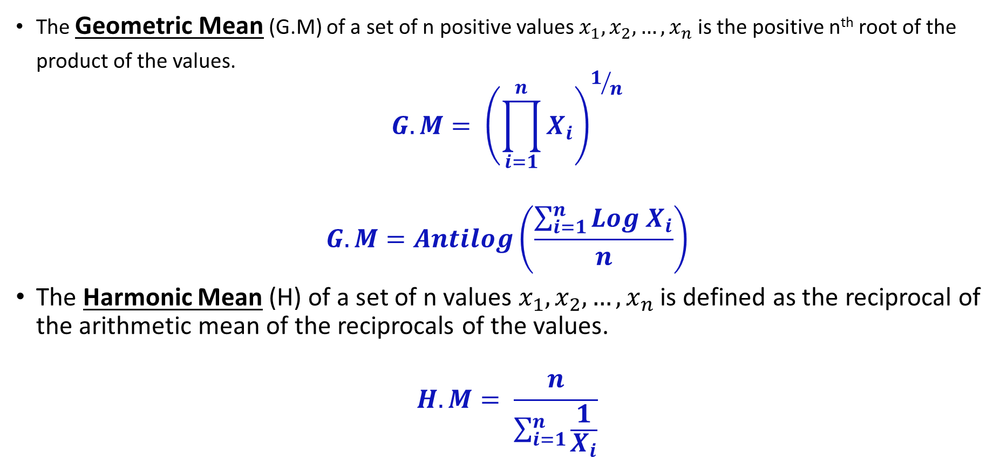
Geometric mean & harmonic mean
The Geometric Mean (G.M) of a set of n positive values $x_{1},x_{2},…,x_{n}$ is the positive n^{th} root of the product of the values.
$$G.M= {\left(\prod_{i=1}^{n}{X_{i}}\right)}^{1/n}$$
$$G.M=Antilog\left(\frac{\sum_{i=1}^{n}{{Log X}_{i}}}{n}\right)$$
The Harmonic Mean (H) of a set of n values $x_{1},x_{2},…,x_{n}$ is defined as the reciprocal of the arithmetic mean of the reciprocals of the values.
$$H.M= \frac{n}{\sum_{i=1}^{n}{\frac{1}{X_{i}}}}$$

Slide 16
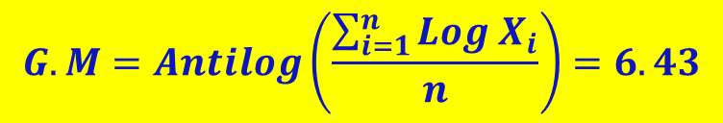
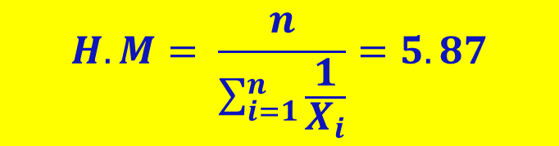
Example
Find Geometric Mean and Harmonic Mean from the following data?
X
3
5
6
6
7
10
12
49
Log (X)
0.477
0.699
0.778
0.778
0.845
1.000
1.079
5.6567
1/X
0.333
0.200
0.167
0.167
0.143
0.100
0.083
1.1929
$$G.M=Antilog\left(\frac{\sum_{i=1}^{n}{{Log X}_{i}}}{n}\right)=6.43$$
$$H.M= \frac{n}{\sum_{i=1}^{n}{\frac{1}{X_{i}}}}=5.87$$

Slide 17
Mode
The most frequent value also called nominal average
can be used for qualitative as well as quantitative data
may not be unique
may not exist
computation of the mode for ungrouped or raw data
0 1 2 3 4 5 6 7 8 9 10 11 12 13 14
0 1 2 3 4 5 6
No Mode
Mode = 9

Slide 18
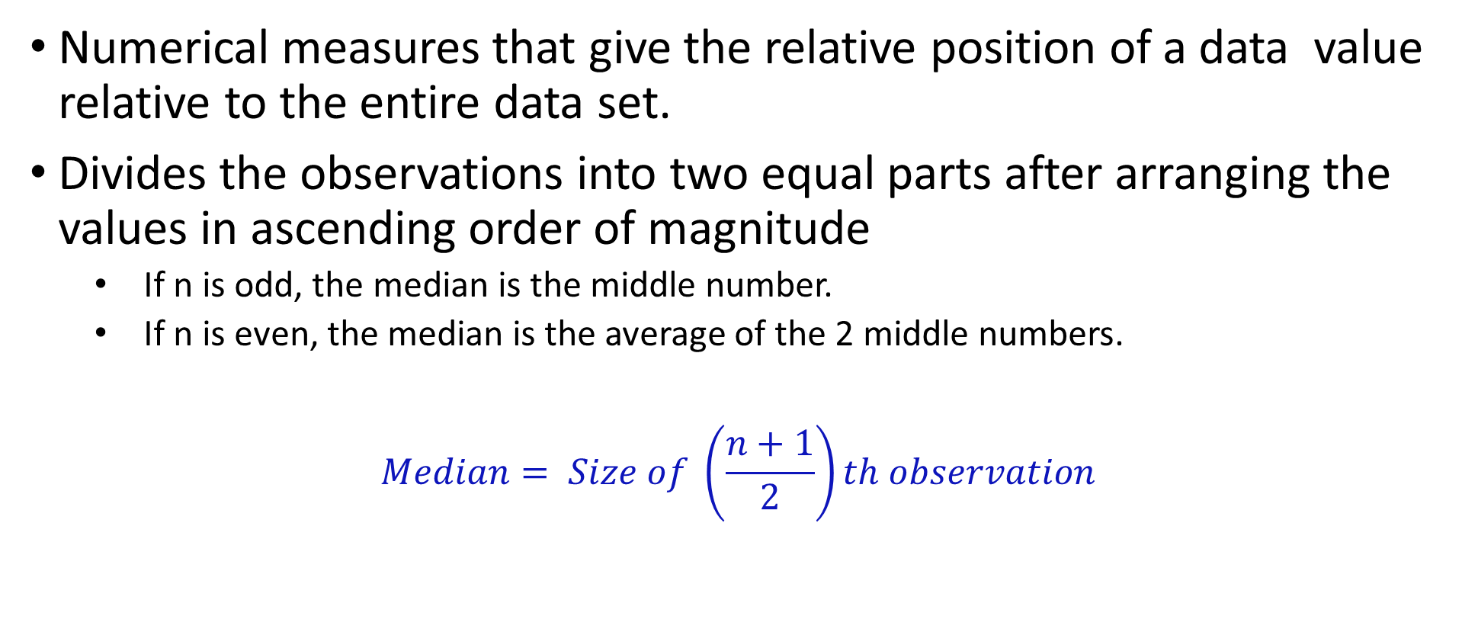
Median
Numerical measures that give the relative position of a data value relative to the entire data set.
Divides the observations into two equal parts after arranging the values in ascending order of magnitude
If n is odd, the median is the middle number.
If n is even, the median is the average of the 2 middle numbers.
$$Median= Size of \left(\frac{n+1}{2}\right)th observation$$

Slide 19
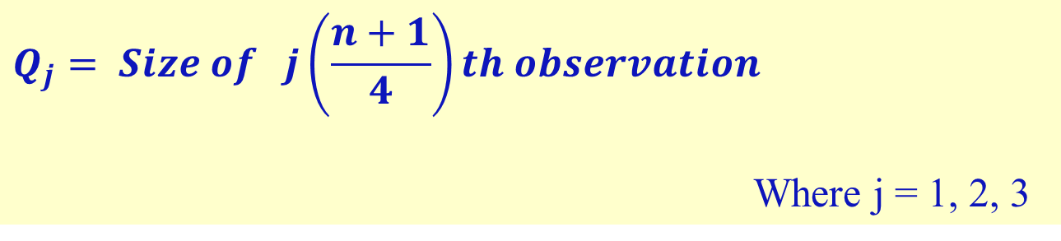
Quartiles
Divide an array into four equal parts, each part having 25% of the distribution of the data values, denoted by Q_{j}
25th of the observations are below the 1st quartile.
1st quartile is the 25th percentile; the 2nd quartile is the 50th percentile, also the median and the 3rd quartile is the 75th percentile.
$$Q_{j}= Size of j\left(\frac{n+1}{4}\right)th observation$$
Where j = 1, 2, 3

Slide 20
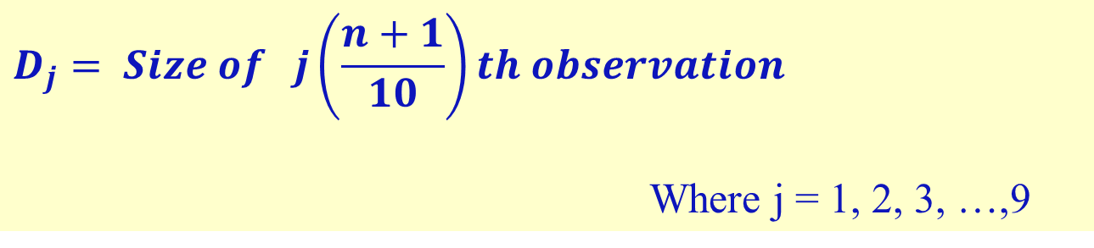
Deciles
Divide an array into ten equal parts, each part having ten percent of the distribution of the data values, denoted by D_{j}
10 percent of the total observations fall below D₁ and the rest 90% are above it.
5th Decile is equal to the Q₂ and Median
$$D_{j}= Size of j\left(\frac{n+1}{10}\right)th observation$$
Where j = 1, 2, 3, …,9

Slide 21
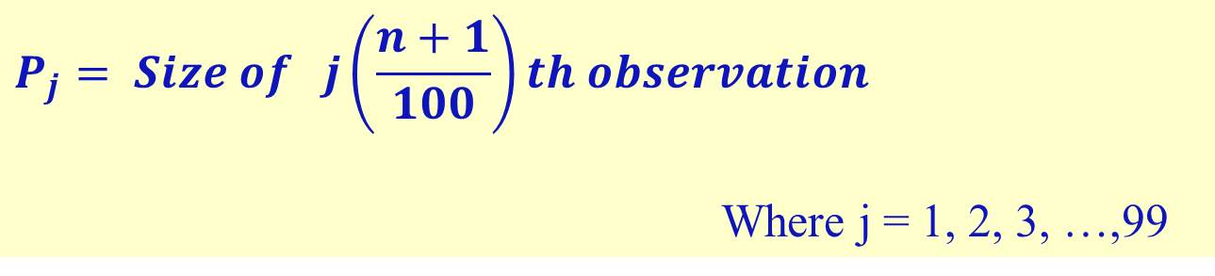
Percentiles
Divide an array (raw data arranged in increasing or decreasing order of magnitude) into 100 equal parts.
The j^{th} percentile, denoted as P_{j}, is the data value in the data set that separates the bottom j% of the data from the top (100-j)%.
$$P_{j}= Size of j\left(\frac{n+1}{100}\right)th observation$$
Where j = 1, 2, 3, …,99

Slide 22

Example
Suppose ALI was told that relative to the other scores on a NTS test, his score was the 95th percentile i.e., his percentile score is 95. How do we interpret it?
➔ This means that 95% of those who took the test had scores less than or equal to Ali’s score, while 5% had scores higher than Ali’s.

Slide 23
Exercise
Find Median, Q₁, Q₂, Q₃ of the following data D₁, D₅, P₁₀ and P₅₀ for the following data of marks obtained by 20 students? Also show that Median = Q₂ = D₅ = P₅₀ ? Also interpret the results?
First of all arrange the data in ascending order of magnitude
53 | 74 | 82 | 42 | 39 | 28 | 20 | 18 | 68 | 58 | 54 | 93 | 70
30 | 61 | 55 | 36 | 37 | 29 | 94
Sr. No. | 1 | 2 | 3 | 4 | 5 | 6 | 7 | 8 | 9 | 10 | 11 | 12 | 13 | 14 | 15 | 16 | 17 | 18 | 19 | 20
 | 18 | 20 | 28 | 29 | 30 | 36 | 37 | 39 | 42 | 53 | 54 | 55 | 58 | 61 | 68 | 70 | 74 | 82 | 93 | 94

Slide 24
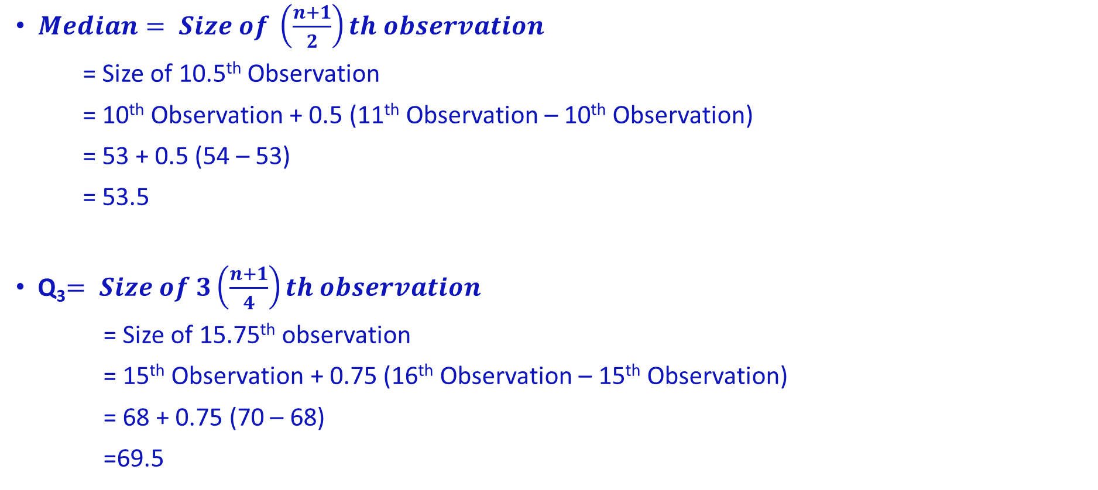
Median & Quartiles
$Median= Size of \left(\frac{n+1}{2}\right)th observation$
= Size of 10.5th Observation
= 10th Observation + 0.5 (11th Observation – 10th Observation)
= 53 + 0.5 (54 – 53)
= 53.5
Q₃$= Size of 3\left(\frac{n+1}{4}\right)th observation$
= Size of 15.75th observation
= 15th Observation + 0.75 (16th Observation – 15th Observation)
= 68 + 0.75 (70 – 68)
=69.5

Slide 25
Example
Consider the following data of marks of 20 students:-
Construct Boxplot of the data and interpret it.
Minimum = 20
Q1 = 36.25
Median = 54.5
Q3 = 73
Maximum = 94
53 | 74 | 82 | 42 | 39 | 28 | 20 | 81 | 68 | 58
54 | 93 | 70 | 30 | 61 | 55 | 36 | 37 | 29 | 94

